Slide 1
Costco and Walgreens
By SM131 Team 2

Slide 2



Meet The Team
Kelvin Lin
Dolan Grisbaum
Meghana Edpuganti

Slide 3


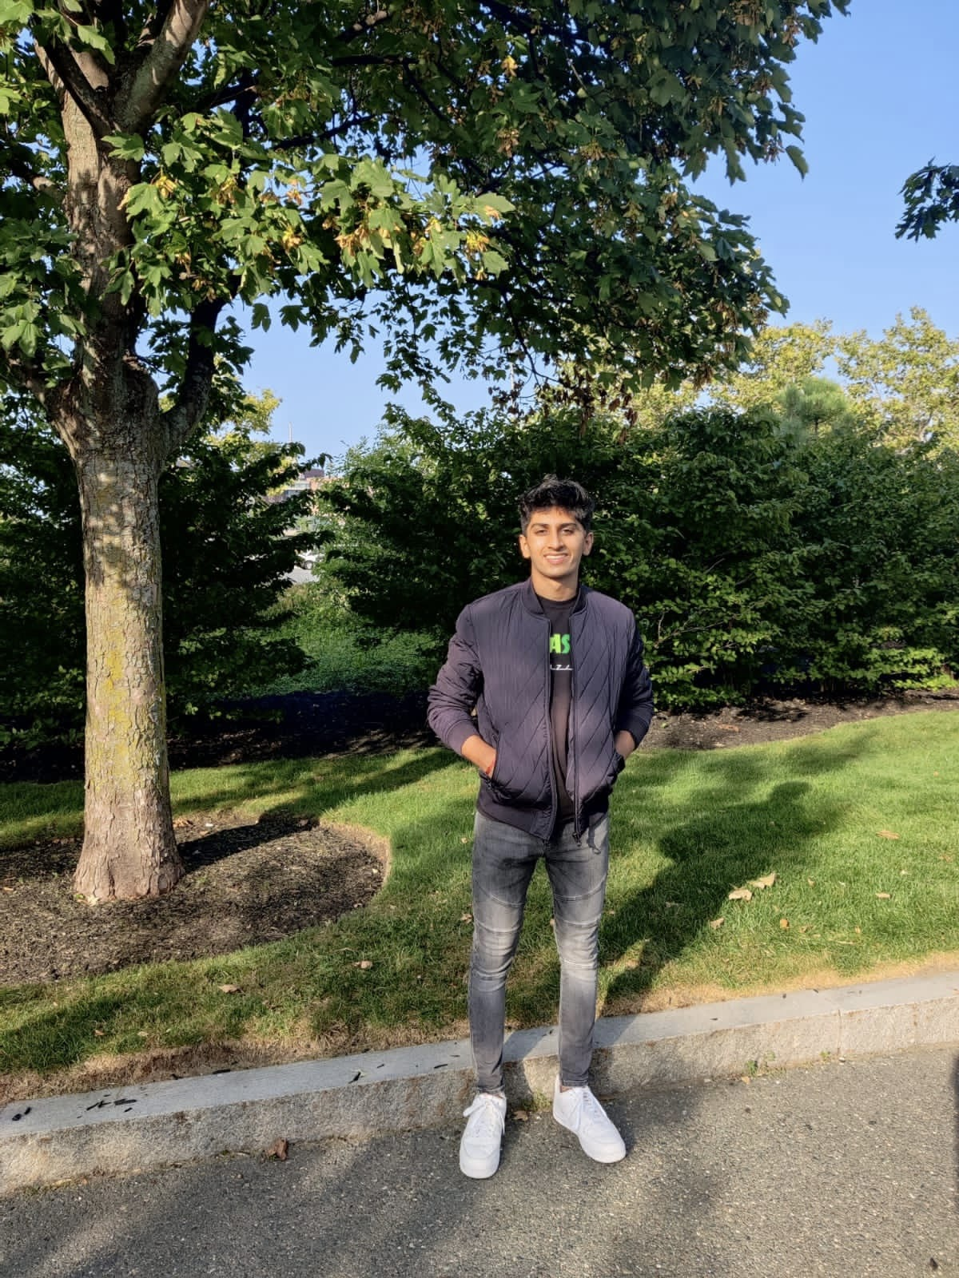
Meet The Team
Magnus Nguyen
Sophie Cutter
Siddhant Nahar

Slide 4


Today’s Agenda
Introduction
Meet The Team
Today’s Agenda
- Thorough Examination of Costco as a Company
- Financial Health Of Costco
- Thorough Examination of Walgreens as a Company
Financial Health of Walgreens
Industry Ethicality
Is Marketing Exploitative?
Regarding Pollution and Food Waste in the Industry
Social Impact

Slide 5
Notes:
We recommend Costco

Slide 6


What Exactly is Costco?
According to Costco…
Costco is a membership warehouse club, dedicated to bringing our members the best possible prices on quality brand-name merchandise

Slide 7
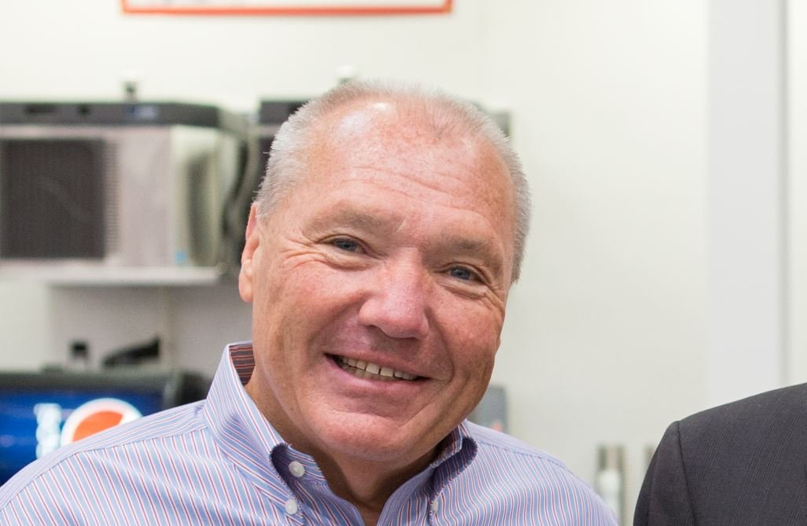
It all Starts at the Top…
W. Craig Jelinek
CEO of Costco since 2012
San Diego State University Alum
90% Employee Approval Rating (Glassdoor)

Slide 8



A Fantastic Place to Work (According to GlassDoor)
Culture/Diversity
Work Life
Trajectories
Culture/Values: 3.9
Diversity/Inclusion: 4.0
Work/Life Balance: 3.4
Compensation/Benefits: 4.4
Career Opportunities: 3.9
AND
74% of employees felt that Costco had a positive business outlook

Slide 9

Low Prices is the name of the Game
BusinessInsider found that:
Costco beat Amazon’s per-unit pricing on 79/100 products researched
Savings were greatest in household staples
Even when beat, the margin was slim

Slide 10

Memberships: A Smart Business Decision
Gold Membership
Executive Membership
Standard 60$/Year Membership
Less benefits to customers
Upgraded $120/Year Membership
More benefits to customers
Promotes Brand Loyalty
Effective Theft Deterrent
Important Revenue Stream, Which Keeps Prices LOW!
Notes:
More Benefits for the Customer!

Slide 11



Costco’s signature brand
Kirkland Brand Logo
Costco’s Trademark Private Label Brand
Innovative, Creative, and Synonymous With High Quality
Costco Does NOT Produce the Items Sold Under the Brand
Produced by Other Companies
Low Prices For High Quality

Slide 12
The Costco Strategy
S
Strengths +
800 Locations
Unique Model
Brand Loyalty
Strong Online Presence
- Global
Variety of Services
W
Weaknesses –
Warehouse Model Adaption
Influential Competitors
Shipping Costs
O
Opportunity +
Large International Market
Advertising
Acquisition of Smaller Retail Chains
T
Threat –
Increasing Competition
Governmental Policies
Taxation
Labor Wages
Brand Switching
Segmentation: Customers Purchasing Households Items
Targeting: Middle/Upper Class Households
Positioning: One of the Largest Retail Chains Globally
Notes:
Segmentation: Customers Wanting to Purchase Daily Need Consumer Needs

Slide 13
Costco’s Finances (YOY): A Healthy Company

Slide 14
Costco’s Finances (YOY): A Healthy Company

Slide 15
Costco’s Finances (YOY): A Healthy Company

Slide 16
Costco’s Margins
Year | 2020 | 2019 | 2018
Gross Margin (%) | 13.09% | 12.98% | 13.01%
Operating Margin (%) | 3.26% | 3.10% | 3.16%
Profit Margin (%) | 2.43% | 2.43% | 2.25%

Slide 17


Slide 18

What Exactly is Walgreens?
According to Walgreens…
Walgreens is one of the nation’s largest drugstore chains, is included in the Retail Pharmacy USA Division of Walgreens Boots Alliance, Inc., a global leader in retail and wholesale pharmacy

Slide 19
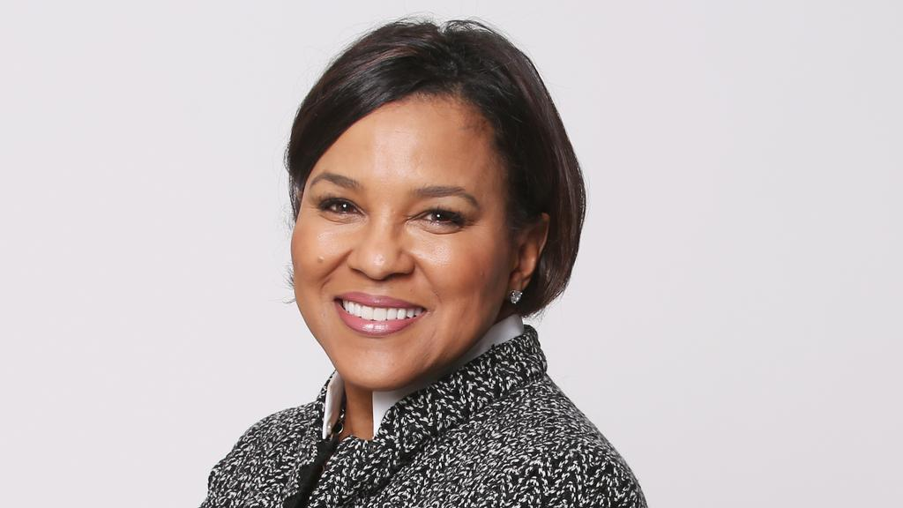
Maybe time for a Change…
Rosalind G. Brewer
CEO of Costco since 2021
Spelman College, UChicago, Stanford, UPenn Alum
40% Employee Approval Rating (Glassdoor)

Slide 20


Devastatingly Average (According to GlassDoor)
Culture/Diversity
Work Life
Trajectories
Culture/Values: 2.9
Diversity/Inclusion: 3.5
Work/Life Balance: 2.7
Compensation/Benefits: 2.9
Career Opportunities: 3.1
ONLY
33% of employees felt that Walgreens had a positive business outlook

Slide 21


Convenient Convenience
Provides Value Through:
Providing Convenience to the Customer
Partnerships With DoorDash, Uber, Act Fast and Medline With Two Hour Delivery Times
Pharmacies on the Premises
Fast and Free Covid-19 Vaccines/Testing

Slide 22


Walgreens’ Backbone
Walgreens Pharmacies Fulfilled 287.6 Million Prescriptions in 2020
59.4% of Revenue Contribution in 2019
Pharmaceutical Wholesale Accounted for 15.3% of Revenue
More Than 85,000 Healthcare Service Providers

Slide 23
The Walgreens Strategy
S
Strengths +
Strong Brand Recall
CSR Initiatives
Strong Employee Base
W
Weaknesses –
High Marginal Pressure
International Presence
O
Opportunity +
Smooth Healthcare Solutions
Global Expansion
T
Threat –
Governmental Regulation
High Rivalry
R&D Efforts
Segmentation: Middle/Upper Class Individuals
Targeting: Pharmaceutical And Drug Detail Business
Positioning: Affordable Pricing On Wide Variety of Healthcare Products
Notes:
8000+ Locations
Strong Brand Recall
CSR Initiatives
Strong Employee Base

Slide 24
Walgreens’ Finances (YOY): A Stagnating Company

Slide 25
Walgreens’ Finances (YOY): A Stagnating Company

Slide 26
Walgreens’ Finances (YOY): A Stagnating Company

Slide 27
Walgreens’ Margins
Year | 2020 | 2019 | 2018
Gross Margin (%) | 20.08% | 21.97% | 23.41%
Operating Margin (%) | 0.94% | 3.65% | 4.78%
Profit Margin (%) | 0.30% | 2.89% | 3.82%

Slide 28

Ethicality In the Industry
An Exploration of:
Is Marketing Exploitative and/or Unethical?
Pollution and Food Waste Issues
In Response to Social Issues

Slide 29

The unethicality of Exploitative Marketing
Prevalence of Obesity in Children and Adolescents was 19.3% (!) (CDC)
Affects around 14.4 Million Children and Adolescents in the United States
Obesity in Children Increases The More Hours of TV Watched (APA)
Ads Shown to Children are Dominated by Unhealthy Food Products
Should Companies be Held Responsible for This Issue?
Notes:
America’s Childhood Obesity Epidemic
Prevalence of Obesity In Children and Adolescents was 19.3% (!) (CDC)
Affects Around 14.4 Million Children and Adolescents in the United States
Obesity In Children Increases The More Hours of TV Watched (APA)
Ads Shown To Children Are Dominated By Unhealthy Food Products
Should Companies Be Held Responsible For This Issue?

Slide 30


Our Responsibility to the environment
Pollution
Food Waste
Recycling
Failing scores (Greenpeace)
Greenwashing by companies
Landfill Diversion (75.7%)
GHG Emission Initiatives
World wastes around 1.4B tons of food annually
Partnerships
Food Donations
Composting Initiatives
Recycling Initiatives
600,044 Tons of Cardboard and Plastic Wrap
6.49m Tires
5.67m Lbs of Paper
Notes:
All the assessed supermarket chains received failing scores (Greenpeace)

Slide 31


Caring in an oft Uncaring World…
Trust, Care, Innovation, Partnership, and Inclusion
Racial Justice and Inequity Initiatives
Countless Collaborations with Healthcare Providers
Mental Health Resources

Slide 32
Recommendations

